Slide 1
Spring
Notes:
5 minutes
Facilitator Note: Please note any housekeeping issues, such as in-person bathroom locations or virtual recordings happening, etc. Let participants know you will be providing breaks during the training, with the frequency or length tailored to meet the participants’ needs.
Do:
Introduce the team and any support staff so they know who to send questions to if they have any issues.

Slide 2
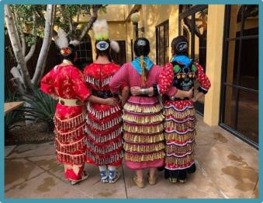
Respecting Our Time Together
Let’s review what we agreed upon for our reciprocal relationship:
Be on time
Engage
Keep conversation relevant
Maintain confidentiality about what is discussed in this space
Openly share experiences, thoughts, & ideas
Be concise, respect time/don't dominate conversation, and allow others to share
Respect each others' ideas
Participate, Participate, Participate
Notes:
5 minutes
Say:
We are sharing some ideas for our reciprocal relationship here but would like to give you a few minutes to review and add to our guidelines for our interaction going forward.
Ask:
Are there any more considerations you would like to add?
Do:
Give a few minutes for participants to add guidelines.
Say:
Thank you to everyone for helping create this respect for our time together. We will revisit these at the beginning of each day.

Slide 3
Note of Caution
There may be instances during this training process in which difficult content is discussed, and participants may experience thoughts and feelings that they weren’t expecting. It is always ok to reach out for help with processing these thoughts and feelings to:
Facilitators
Friends
Community Members
National Organizations
Free Resources:
Visit https://www.opencounseling.com/hotlines-us
Call NAMI at 1-800-950-6264 or text NAMI to 741-741
Notes:
5 minutes
Say:
We know that child welfare can be a trying field even on the best of days. As we move into these training days, we want to acknowledge that the material being covered may be difficult to talk about or listen to. We encourage you to take care of yourself and reach out for help if needed. This slide notes some available resources, and we are always here to talk if needed.

Slide 4
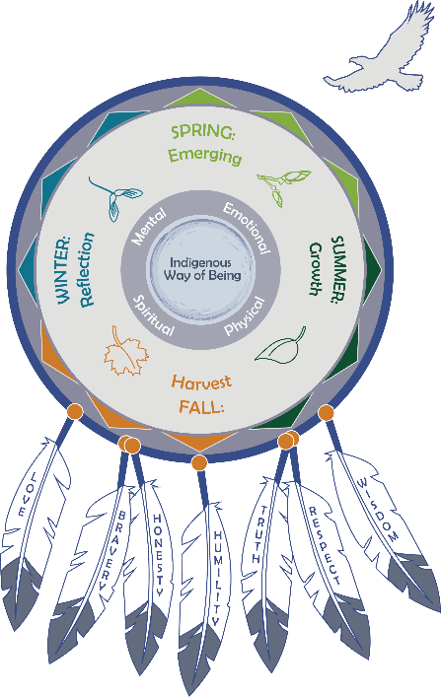
Foundation of the Tribal Child Welfare Leadership Training
This training has been informed by Indigenous leaders, elders, and experienced child welfare experts.
A child is a sacred gift, and we need to consider how every decision impacts future generations.
We respect and honor every tribe’s unique cultural beliefs, values, and practices.
This training is based on seasonal cycles through generational interconnections.
Notes:
5 minutes
Facilitator Note: Based upon the arrangement and flow of the training, this foundation for the training can be introduced during the times you come together. This doesn’t need to be covered in every session, but if there is a large break between facilitations, then please give participants a refresher on the foundations of this training.
Say:
How you lead and the choices you make can have ripple effects. Success in tribal child welfare programs is achieved when tribal child welfare leaders, tribal leaders, and the community work together and know children are sacred gifts who need to be connected to kin, community, and their environment. These collaborations provide a collective vision to honor the rights of Indigenous children for the next seven generations.
The intention of this training is to help you build upon your Indigenous leadership skills to build strength and resiliency for your program. Our hope is that you will find universal connections to your own nation’s cultural beliefs and that you will bring your unique perspective to our conversations, so we can all work together to build upon tribal sovereignty.
Tribes who want to implement the training locally can use their own cultural beliefs, practices, and values. No landscape is the same, and all seeds need special conditions to successfully grow. What you can grow may be limited by the resources you have available. Or you may need to change your environment to grow what is needed to serve your people. We honor and respect all the landscapes you are bringing together in this room, and we hope you can find universal truths in the material we are providing.
Throughout this training, we will explore the historical events that shaped our current realities and consider the future of our tribal nations for the next seven generations.

Slide 5
Today’s Agenda
Indigenous Circles of Leading
Preparing Your Soil
Indigenous Values: Seven Grandfather Teachings
The Eagle’s View
Recognizing Our Trauma in Our Work
Tending to Your Growth: Self-Care
Maintaining Balance and Harmony Through the Cycle of Seasons
Intergenerational Protective Circles of Care
Indigenous Adaptive Leadership
Technical vs. Adaptive Leadership
Margaret’s Story
Case Study: Applying Margaret’s Story
* Breaks will be worked into the day
Notes:
3 minutes
Do:
Review what will be covered today and ask if anyone has any clarifying questions or comments before we begin.
Indigenous Circles of Leading
Preparing Your Soil
Indigenous Values: Seven Grandfather Teachings
The Eagle’s View
Recognizing Our Trauma in Our Work
Tending to Your Growth: Self-Care
Maintaining Balance and Harmony Through the Cycle of Seasons
Intergenerational Protective Circles of Care
Indigenous Adaptive Leadership
Technical vs. Adaptive Leadership
Margaret’s Story
Case Study: Applying Margaret’s Story
Remind everyone that they received a participant workbook that they can follow along in.

Slide 6
A Shared Learning Process
Pre-Facilitation Connection
Coaching
Training Sessions
Discussion
Reflection
Shared Learning Activities
Notes:
2 minutes
Facilitator Note: The slide lists the various methods that the Center for Tribes provided when facilitating. For your training, on this slide you can add to or delete the specific modalities you will or won’t provide.
Say:
The primary focus of this training is on the self. We believe that when we create strong internalized leadership skills, those skills radiate out to our work with others, which will help grow our programs, communities, and tribes.
As we move through this journey together, we will teach you new concepts, give you space to reflect, and allow you each to connect with one another in this safe space.
We are all on this path together, and we encourage you to share your thoughts and ideas as we move together.

Slide 7
Storytelling Bingo Activity
Let’s Connect!
3 Rounds
10 Minutes Each Round
1st Chance to Win
Notes:
35 minutes
Facilitator Note: To complete this bingo activity, each participant needs a pen and a printed bingo card, which is in the participant workbook. Participants will mingle in small groups and mark off squares as they meet people who fulfill the traits listed. Participants will use this same card each day, so remind them to bring the card back for the next session.
Say:
Before we begin the training, let’s find out a little more about each other.
As we start our training, we want to break into small groups and do an activity to get to know one another. During this training, you’ll have many opportunities to share stories and fill up your bingo cards!
We want to honor that storytelling is a part of Native traditions. We hope you enjoy the connection that storytelling bingo provides.
Facilitator Note: Here are the bingo instructions for this activity:
The objective of this activity is to tell your story and ask others for their story. Break into groups of three for 10 minutes and choose one topic in a square; then each of you share a story. Write in their answers below the topic on your card. We will do three rounds of interaction each morning. Throughout the next few days of training, you will have additional opportunities to fill in your squares. The object of “Storytelling Bingo” is to fill in each square for “Blackout Bingo” (every square to be filled).
Do:
Explain “Storytelling Bingo” instructions.
Break participants into small groups, aiming for three people per group. Give each group 10 minutes to talk, and then switch groups. Do this three times, over 30 minutes. Bring everyone back together after the three rounds.
Say:
We would now like to move to a review of our tribal child welfare leadership model, so please turn to this handout in your workbook.

Slide 8
Indigenous Circles of Leading: An Eagle’s View
Notes:
10 minutes
Do:
Refer participants to the laminated copy received in their welcome packet. Having a physical copy allows them to see the model much clearer as we go through the description of how this shaped the training concepts. Remind them that they can also find this in their participant workbook.
Say:
This training has been influenced and adapted from pilot deliveries to tribal child welfare leaders. Historically, we know that Indigenous ways of learning occur through oral traditions—storytelling and analogies passed down from generation to generation. In the formation of this training, we honored these ancestral ways of teaching and built this training upon an Indigenous holistic connectedness from our being to all things around us.
As a general overview, the “Indigenous Circles of Leading” model illustrates an eagle’s view of the interconnectedness we have with all relations. Whether we are Native or non-Native, we are serving Native children and families, and understanding this way of leading is a pathway to healing, reconciliation, and resiliency within the communities we serve. It also promotes better outcomes for our future. You will remember some of this from the “Indigenous Circles of Leading” video that you watched before our training sessions began.
Understanding our interconnectedness as a tribal child welfare leader is the foundation to building upon the “Indigenous Circles of Leading” model.
The circle surrounding the “Indigenous Way of Being” is symbolic of a universal Indigenous medicine wheel of our emotional, physical, spiritual, and mental well-being. An Indigenous way of being encompasses identity, strengths and weaknesses, and purpose. In this work, our way of being is to honor and respect the sacred gifts of children and recognize our service to others in contributing to the health and wellness of all. Our way of being is in a continual transformation of ourselves and the work we do.
Facilitator Note: If you want to suggest additional resources, Don L. Coyhis has devoted much of his life to teaching well-being, and one of his books, Understanding Native American Culture, provides insights of recovery and healing for wellness practitioners. It’s a good resource for understanding the medicine wheel and being in balance with ourselves and in relation with others. Also, on our Tribal Information Exchange website, those interested can find the following resource devoted to understanding the medicine wheel: A Guide to Presenting & Facilitating Teachings of the Medicine Wheel (https://tribalinformationexchange.org/index.php/2017/07/20/a-guide-to-presenting-facilitating-teachings-of-the-medicine-wheel/)
Say:
Sometimes you may hear someone refer to a cultural lens, and you may not have been completely sure how to define it. For this training, a cultural lens is how we see things through all four quadrants of the medicine wheel. Our cultural lens is intergenerational, moving backward and forward through time.
These circles are not stagnant. They are holistic and continually flow between and within one another, much like a small river flowing into the ocean. Our interconnectedness with ancestral teachings and ceremonies sustains our path and well-being into the future. Our ways keep us connected to the Creator and all gifts around us.
Through a shared learning activity, we want you to explore some questions about how you experience this leadership model.
Do:
Direct participants to the model in their workbook. There is also a handout that has the model’s image, but the words have been removed. This blank handout is what they should use to answer the questions.
Say:
Take a few minutes to reflect on these questions, which are also listed in your workbook. You can write your answers on the blank model handout in your workbook:
What do the seasons mean to you and your tribe?
What are your tribal values?
What does the eagle’s view mean to you?
What about the model stands out most for you?
Do:
Provide a few minutes for learners to think through the questions and write down a few answers.

Slide 9
For Everything There Is a Season and a Time for Every Purpose
Notes:
5 minutes
Say:
In the model, the outer circle is the cycle of seasons. Today, we are going to be focusing on spring. This outer circle also includes the four directions, impacted by the sky, earth, animals, and plants, and the dimensions of health in maintaining balance and harmony.
The conceptual framework of leading a child and family organization parallels a seasonal cycle. The seasons continually cycle and adapt to changes and growth in the environment. In many traditional cultures, the cycle of seasons is synonymous with ceremonies to restore and maintain harmony. Ceremonies are representative of the balancing of the cycles and the interdependence of all beings.
Seasonal cycles inform our training sessions.
Ask:
What do the seasons mean in your tribal nation?
Do:
Allow a few participants to answer.
Facilitator Note: You can fill in and share these ideas scattered throughout responses.
• Spring is the emergence, awakening, renewal, and growth from planting seeds. It is the time for our visions to take root and grow. An individual or organization embraces this stage of life as a time to build relationships through growing and nurturing. It’s seen as a learning phase where we can democratize leadership, recognize the ecosystem, and consider our leadership choices.
• Summer is one of the longer seasons, and the sun has a higher position for a time. This season includes growth, which mobilizes and grounds resources. Individual and organizational growth continues through practice, energy, team building, focusing, and modeling self-care while recognizing trauma. In summer, we nurture our vision and seek knowledge to build strength.
• Fall is a harvesting time when growth is full and strong. This is a season of preparation and adaptation as we get ready for the upcoming winter. A time for celebration, we recognize personal mastery, and at an organizational level, the path opens to an acceptance of the journey to the current realities as we begin to understand adaptive change.
• Winter is a quiet time to reflect on prior seasons, and we often dig into this reflection through storytelling. Self-reflection and organizational reflection provide a systemic process for considering feedback, evaluating progress, and considering progressive outcomes for creating a preferred future. For many, this season can also hold many celebrations and ceremonies.
Say:
Earlier, we mentioned the training uses seasonal cycles. We will now enter the springtime—a space of awakening, preparing, and planting.

Slide 10
Spring – Awakening, Preparing, and Planting
Learning Outcomes:
Explore the seasons’ individual leadership built upon relationships and Indigenous intergenerational connectedness.
Apply the “Indigenous Circles of Leading” model to your individual and organizational leadership.
Explore how change happens through growing, nurturing, learning, practicing shared leadership, understanding context, and making choices for continued growth.
Recognize that each of us has moments of leadership that we can choose to take and why we should do so, no matter our official role in the organization.
Provide a framework based on the eagle’s view for Indigenous ways of leading and growing.
Notes:
5 minutes
Say:
The learning outcomes for today are listed on the slide and are also in your workbook. Please take a moment to read the outcomes [or have participants read them out loud].
One concept you will hear many times is connectedness or interconnectedness based on Indigenous understandings. Each season is a time for us to acknowledge our actions for beginning and nurturing growth. The learning outcomes will build upon each season as we move along our leadership journey.
Facilitator Note: The learning outcomes are to:
• Explore the seasons’ individual leadership built upon relationships and Indigenous intergenerational connectedness.
• Apply the “Indigenous Circles of Leading” model to your individual and organizational leadership.
• Explore how change happens through growing, nurturing, learning, practicing shared leadership, understanding context, and making choices for continued growth.
• Recognize that each of us has moments of leadership that we can choose to take and why we should do so, no matter our official role in the organization.
• Provide a framework based on the eagle’s view for Indigenous ways of leading and growing.

Slide 11
Preparing Your Soil
From Froman _ on YouTube: https://www.youtube.com/watch?v=vcumm0CeDcw
Notes:
5 minutes
Facilitator Note: You should play about thirty seconds of this video to show a landscape changing with the season. The video is 23 seconds.
Do:
Play the video that shows winter thawing and spring emerging.
Say:
In this video, the landscape is unaltered, and with no intervention, you can expect that what is present in the environment will continue to grow, cycle after cycle.
Ask:
If you came into this scene and you wanted to grow something new, what would you need to do to ensure you were successful? What would you need to know?
Do:
Allow time for participants to silently reflect on the questions. If people want to speak up, they can.
Facilitator Note: Highlight these ideas from the responses that participants provide to orient them to the spring season:
• Preparing your soil.
• Bringing people together, getting in the right mindset, connecting, creating a community of connectedness from the beginning.
• Assessing your environment. What needs to be done to plant what you want to grow? (e.g., fertilizing and tilling the soil, knowing the seasons and what to expect).
• If choosing to leave untended, the seasons still happen, but the landscape rarely changes without planning and work.

Slide 12
Indigenous Values: Seven Grandfather Teachings
Notes:
5 minutes
Say:
Outside of the circle is the eagle and his feathers. The eagle feather is sacred to us and gifted to us so that we remember our values, where we come from, and where we are going. The feathers at the bottom are the seven grandfather teachings from our Anishinaabe relatives. We want to emphasize that we respect every tribal nation’s beliefs, history, and culture, and we acknowledge that they each have their own values and beliefs. We use the seven grandfather teachings as an example but invite you to explore how your own tribal values may use similar teachings.
The seven grandfather teachings are:
Love – Embrace peace and have unconditional regard for others.
Bravery – Act with integrity even when fearful.
Honesty – Keep one’s word and behave in an honorable way.
Humility – Know your place in the larger picture and do not put yourself above the Great Spirit, animals, plants, or other life.
Truth – Be honest with yourself and others.
Respect – Treat others in a caring manner and with dignity.
Wisdom – Value knowledge and learning throughout one’s life.
The following questions are in your workbook, where you can jot down your responses.
Ask:
What do these eagle feathers mean to you as a leader?
Do:
Take a moment to think about your own tribal values and beliefs.
Share with the group any values or beliefs that are different or any that could be added to this list.
Ask:
How are some values the same but expressed in different ways?
Do you see shared values that transcend culture?
Do:
Provide space for participants to respond.
If you can, capture some of these thoughts on a piece of flip chart paper so that everyone in the room can see the values for the day.
Facilitator Note: You can refer to these after participants share what it means to them. The seven grandfather teachings are:
• Love – Embrace peace and have unconditional regard for others.
• Bravery – Act with integrity even when fearful.
• Honesty – Keep one’s word and behave in an honorable way.
• Humility – Know your place in the larger picture and do not put yourself above the Great Spirit, animals, plants, or other life.
• Truth – Be honest with yourself and others.
• Respect – Treat others in a caring manner and with dignity.
• Wisdom – Value knowledge and learning throughout one’s life.

Slide 13
The Eagle’s View
Effective leadership is active and reflective. Taking a view from above the fray provides a holistic approach to see patterns, relationships, contexts, and visionary practices.
Notes:
5 Minutes
Say:
We now move above and see the interconnectedness from an eagle’s view. An eagle is a symbol of strength and courage, and we can also view it as a messenger. They have powerful wings and will soar and glide on wind currents, viewing the land below. From an eagle’s view, the “Indigenous Circles of Leading” embodies a process of continual balance and restoration to build resilience and well-being in ourselves and the work that we do.
Leading requires not only understanding the individual tasks of staff and regulating their performance (which is management), but also needing to take a view from above the fray to see the patterns, relationships, context, and implications (which is leadership). Being an effective leader is both active and reflective.
When we are on the earth looking around, we are only able to see what is close to us, so we may miss seeing the larger perspective. It’s only when we take the eagle’s view and fly above everything that we can look down and see patterns. This perspective is essential for assessing the environment for change, which is reflected in the saying, “can’t see the forest for the trees.” Practicing this holistic view and honoring intergenerational connectedness provide guidance for change.
Ask
How can taking an eagle’s view help you as a leader?

Slide 14
Shared Learning Activity
What Stands Out for You?
Indigenous Way of Being
Balance and Harmony
A Time for Every Season
Cultural Beliefs and Values
Notes:
20 minutes
Say:
For this shared learning activity, we’d like for you to reflect on how this applies to your work. Consider how the “Indigenous Circles of Leading” and taking an eagle’s view apply to your leadership within a tribal child welfare program.
For each of the circles consider the approach and what stands out for you:
Indigenous Way of Being
Balance and Harmony
A Time for Every Season
Cultural Beliefs and Values
We will now break out into small groups to discuss your answers to the questions for 15 minutes. When you return to the large group, be prepared to share some of your thoughts.
Facilitator Note: Tie this back to respect and honor of the tribes, where they come from, and how it is honoring differences in these concepts for them.
Do:
Set up groups of three, face-to-face seating preferred with no tables.
Provide 15 minutes for them to discuss their answers.
Bring everyone back to the larger group and ask for each group to debrief.

Slide 15
Recognizing Trauma in Our Work
Notes:
10 minutes
Say:
Let’s review this infographic that we created with our partners from the National Native Children’s Trauma Center. This handout talks about the 4 Rs of being trauma informed: realize, recognize, respond, and resist. The 4 Rs inform how we respond in leadership moments and the impact on our emotional, physical, spiritual, and mental well-being, but they are also rooted in the resilience that tribes have built from generations of historical trauma.
Ask:
Considering the patterns of presenting responses of trauma because of colonization, how can this help us as leaders create a pathway to healing and resiliency?
Do:
Provide a few minutes for the participants to read the infographic and discuss the ideas.
Do:
Find ways to tie their responses to all elements of the “Indigenous Circles of Leading” model.

Slide 16
Self-Care in Leadership: Tom’s Story
https://youtu.be/2tjtdfEg7QE
Notes:
5 minutes
Say:
Now that we have looked at the 4 Rs, let’s talk a little about self-care.
First, we are going to rewatch a video, Self-Care in Leadership: Tom’s Story. This video was created by our colleague Tom Lidot.
Do:
Play Tom Lidot’s Video.

Slide 17
Tending to Your Growth: Self-Care
Notes:
10 minutes
Ask:
What ways do you tend to your own growth and practice self-care? Consider Tom Lidot’s video and his experience with the elder teaching him to honor self-care and maintain balance and harmony.
Facilitator Note: Revisit emotional, physical, spiritual, and mental well-being explanation. Remind participants that as leaders we are responsible for our own self-care AND creating a culture within the office that lets staff know their self-care is encouraged.
Do:
Provide time for responses in the moment.
Give relevant examples when needed. Share your ways.
Facilitator Note: Here are some examples you may share:
• Emotions are an expression of feelings, mood, response, and purpose derived from our given name, clan, and relatives. An example of balancing one’s emotions is the feelings of love and hate. If one were to consume the other, the emotion can affect our physical, spiritual, and mental well-being.
• “Physical well-being” is understanding our body is a conduit and requires continual self-care for emotional, physical, spiritual, and mental health.
• “Spiritual well-being” means understanding we have an interconnectedness to the Creator and gifts that are appreciated in ceremony. Spirituality is our Indigenous ways of knowing, which include our customs, values, language, and interconnectedness to all things. Cultural attachment provides the strength and resilience to be happy, healthy, and whole.
• “Mental well-being” is focused on our minds and thoughts, which includes knowing our values, ancestral teachings, stories, and beliefs.
Say:
In your workbook, we have provided resources for self-care practices, which you can review when you feel like learning more. These are available on our website, the Tribal Information Exchange, and they can help you to develop moments for self-care. Understanding our reaction and stress to dealing with the unknown can take a toll on our emotional, physical, spiritual, and mental well-being, which are included in the “Indigenous Circles of Leading.” You must tend to them to nurture the growth that will come in summer.
Understand that remaining in balance as a leader allows us to model that for our staff. We know that trauma affects our relatives, our programs, and our nations, so we must engage in a continual cycle of attending to our own self-care. Focusing on all four areas of the medicine wheel ensures balance.

Slide 18
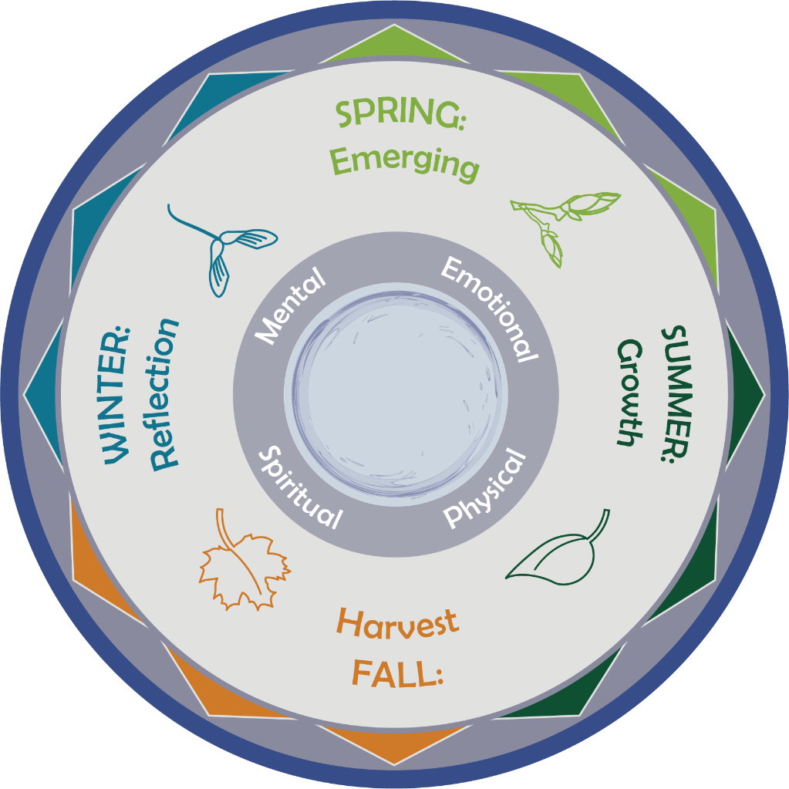
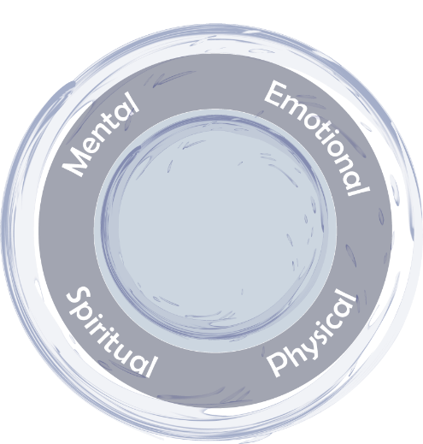
Maintaining Balance and Harmony Through the Cycle of Seasons
Notes:
5 minutes
Say:
Seasons occur in a cycle. We can often tell when the seasons are changing, not only from the climate but the behavior of animals, plant life, and astronomy. In the “Indigenous Circles of Leading,” we begin with spring as a time when we begin a new journey or new project—it is a time to prepare the soil and plant seeds for growth. Consider this a time of moving from an Indigenous way of being to an Indigenous way of doing.
Change can bring fear of the unknown and trigger intergenerational trauma responses. We want to continuously create space to recognize trauma’s impact on emotional, mental, physical, and spiritual growth and any conflicts that may be present.
The questions we are going to now discuss are in your workbook, where you can take notes if you would like.
Ask:
What does it mean to prepare ourselves for the upcoming cycle of growth?
How do we decide where we want to invest our energy and what we want our outcomes to be?
How can we use the knowledge of the 4 Rs of trauma to guide our leadership during growth?
Do:
Ask participants to turn to their neighbor and discuss the questions for a few minutes.
Bring participants’ attention back to the larger group and ask if anyone would like to share.
Facilitator Note: Acknowledging the real experiences people have is important and provides an understanding of responses to change. Below is a summary of the 4 Rs handout, which you can bring into discussion:
• Realize trauma in ourselves, families, communities, and programs.
• Recognize symptoms of trauma.
• Respond with strategies that are trauma informed, acknowledging the past and building strengths for the future.
• Resist re-traumatization in our words and actions, including policy and procedural approaches.
Say:
Let’s now look at how we can see all this together.

Slide 19
Preparation Means Centering Ourselves and Our Organizations in . . .
Our cultural values
Reflection on what it means to live and use the grandfather teachings in our work with the community
How we connect through the “Intergenerational Protective Circles of Care”
Restoring and reawakening our ways for living a good life
Notes:
10 minutes
Ask:
What does “preparing the soil” mean to you?
Consider the “Indigenous Circles of Leading” model and the “Intergenerational Protective Circles of Care.” What do they bring to mind?
Do:
Allow for a large group discussion. If participants feel more comfortable in small groups, you can ask them to turn to their other neighbor to discuss for a few minutes.
Facilitator Note: You won’t want to click the mouse for the bullets to appear until after you have had a short group discussion. The bullets below will fly in, so each individual bullet will appear as you click the mouse. If one appears that you have discussed in the group, you can say, “Look, you covered that already.” If it hasn’t been discussed, you can say, “This one wasn’t an example you gave; let’s talk about that.”
Preparation means centering ourselves and our organizations in:
• Our cultural values
• Reflection on what it means to live and use the grandfather teachings in our work with the community
• How we connect through the “Intergenerational Protective Circles of Care”
• Restoring and reawakening our ways for living a good life
Say:
Now that we have considered the soil of you and your child welfare program, let’s dig deeper into what surrounds us as leaders.

Slide 20
Intergenerational Protective Circles of Care Video Refresher
Available online at: https://youtu.be/p0d4R3fIozU
Notes:
10 minutes
Say:
We are now going to rewatch the video on the Intergenerational Protective Circles of Care.
As you watch think about how this graphic connects to what we’ve discussed today.
Do:
Play the YouTube video, Intergenerational Protective Circles of Care. It is embedded in the slide or available at: https://youtu.be/p0d4R3fIozU.

Slide 21
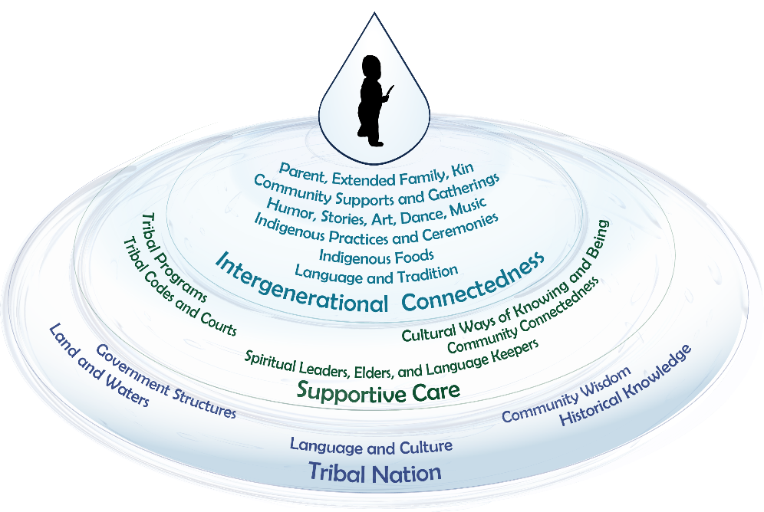
Intergenerational Protective Circles of Care
Notes:
15 minutes
Say:
To be effective, tribal child welfare leaders need to have a deep knowledge about and know how to access these cultural and community resources. Using a nation-building approach allows tribal programs and tribal child welfare leaders to develop and sustain practices, policies, protocols, and structures that further the goals of tribal sovereignty.
Let’s revisit what you learned in the video about the “Intergenerational Protective Circles of Care” model.
At the center of the “Indigenous Circles of Leading” is an “Indigenous Way of Being.” The “Indigenous Way of Being” includes an interconnectedness of our role as leaders within a sovereign tribal nation. While tribal sovereignty is a political status in having the authority and dominion over citizens, sovereignty is also indivisible, meaning it takes into account everything in our way of being as an Indigenous person.
Intergenerational connectedness is best understood as the existing influence on tribal sovereignty from the seven generations before us and seven generations into the future. In tribal child welfare, our focus is on the child, who is a sacred gift as water is sacred and life-sustaining. The diagram is like a pool of water, and when the water is touched, a ripple effect takes place. Each time we come into contact with or touch a child’s life, the ripples move outward and are surrounded by circles, which we define as a protective circle of care. John Trudell said, “every human being is a raindrop, and when enough of the raindrops become clear and coherent, they then become the power of the storm.” This quote symbolizes sovereignty.
From our “Indigenous Way of Being,” we are related to all things. A common goal in tribal child welfare is to serve and provide for the long-term well-being, restoration, and cultural beliefs in a decolonized approach. While the circles—”Intergenerational Connectedness,” “Supportive Care,” and “Tribal Nation”—may vary, every tribe is structured and sustained in similar ways. The graphic provides an Indigenous understanding about the roles and responsibilities of formal and informal helpers in tribal communities. Each of the protective circles plays a critical role, and we’ll go through them in more detail.
Facilitator Note: At this point, click the mouse during the presentation, and the Intergenerational Protective Circles of Care (IPCC) graphic will grow larger so that it is easier to read.
The outer circle or “Tribal Nation” is where tribal sovereignty and nation-building best serve the needs of the nation through governance supportive structures, historical teachings, land, natural resources, and water protection. These structures provide oversight and budgetary authority over tribal child welfare and other programs. The “Tribal Nation” is a protection for the other circles. It is composed of tribal political structures (tribal councils, reservation business committees, etc.). These are often elected tribal officials who have the responsibility to take an eagle’s view to oversee the best interests of the tribe and its people. Their job is to defend tribal sovereignty, both internally and externally. Building on historical knowledge and community wisdom through language and culture sustains an Indigenous way of being. This circle is also responsible for the development and maintenance of environments in the land and water that allow the other circles to flourish. This circle could be seen as the warriors who protect the inner circles. Tribal child welfare leaders must be able to utilize the strengths of tribal culture, families, and organizations to protect and exercise sovereignty.
Supportive care can be informal or formal. Tribal programs or cultural activities support and protect the inner circle, “Intergenerational Connectedness,” and, therefore, families and communities. Formal procedural guides in tribal programs include program policies, tribal codes, law enforcement, and courts. Informally, foundational supportive care is through ceremonies, community gatherings, prayers, communal acknowledgments of life, celebrations, grieving, and renewal. They help to pass on the teachings for how children, families, and communities are to be cared for to remain strong and healthy.
The inner core is the “Intergenerational Connectedness” circle closest to the child, which includes family or relatives, nuclear, extended, and kin systems; clans and other unifying structures; Indigenous ways of knowing and cultural protocols, language and ceremonial beliefs; and access to elders and spiritual leaders who provide spiritual wisdom and guidance. This can include humor, stories, ancestral foods, songs, teachings, art, dance, beading, basketmaking ceremonies, and social gatherings. These practices are unique for every child, family, and community because of the impact of forced assimilation; however, we know restoration of cultural beliefs and practices promotes long-term resiliency and sustainability.
As a whole, consider these protective circles as systems or raindrops that collectively exist to serve the community, prevent disruptions, restore balance, and reconnect to traditional ways of being. These systems serve to implement the tribal nation’s values and norms in practice. A tribal child welfare program is the perfect example. When the program embraces an “Intergenerational Connectedness” framework, it supports family and community well-being by reinforcing cultural norms and practices. However, when a tribal child welfare program takes a mainstream approach in a child’s removal, it can inadvertently further erode cultural ways of sustaining their connection to these circles. Tribal child welfare leaders need to understand the role of their organization in relationship to other community structures to collaborate and exercise adaptive leadership to address the needs and contexts in which they work. Tribal sovereignty is realized in programs that support other intergenerational connectedness systems of the tribe.

Slide 22
Shared Learning Activity
Let’s Talk About:
How is your tribal structure like what was described?
What elements of your tribal structure are not like what was described?
How can you, as a leader in your program, build on the strengths of each circle?
How do you help sustain tribal sovereignty through your programs by planning for the next seven generations?
Notes:
25 minutes
Say:
Let’s take some time to reflect on the “Intergenerational Protective Circles of Care.” We will now move to a shared learning activity.
In your workbook, you have the questions we will be answering, as well as a blank version of the “Intergenerational Protective Circles of Care.” We will be using these for this activity.
Do:
Explain shared learning activity.
Say:
In pairs, you will discuss the four questions on the slide. We will come back and debrief as a larger group, so please have someone ready to share out about your reflections.
Facilitator Note: This activity can be an impromptu networking for a cohort or a 1-2-4-all for 1 tribe. The instructions are located at:
• https://www.liberatingstructures.com/2-impromptu-networking/
• https://www.liberatingstructures.com/1-1-2-4-all/
If using impromptu networking, you will arrange activity in pairs, and the pairs will rotate every four minutes for three rounds. If using 1-2-4-all, they will get two minutes by themselves, five minutes in pairs, and five minutes in quads, and then come back together as a large group for a 10-minute debrief.
Do:
Send the participants into their first group. Use the instructions in the Facilitator Note above to rotate participants, timing of which depends on the activity you select.
After 12 minutes, pull everyone back together for a 10-minute debrief.

Slide 23
What Is the Definition of Leadership?
Eric Martin, Managing Director, Adaptive Change Advisors
https://youtu.be/nTsvbPONw9I
Notes:
5 minutes
Say:
As we begin to talk more about adaptive leadership, we want to ground you in what leadership is and can be. I want to introduce Eric Martin. He is a Detroit native turned prominent leadership expert. Eric has brought leadership development to over 300,000 people in 146 countries. His work extends the framework of adaptive leadership, a somewhat provocative leadership practice developed at Harvard.
He has been an advisor and contributor to this academy by using his framework to recognize and take action when needed to address challenging issues.
Say:
When watching this video, think of how leadership moments show up in your life.
Do:
Play the 2:09 minute video embedded in the PowerPoint slide.
Ask:
After watching this video, do you think is the most important part of what Eric defines as leadership?
Facilitator Note: Leading is about mobilizing, engaging, and elevating people. It’s possible to effect real change when considering leadership as a moment. This emerges from adaptive leadership, which is a set of tools and techniques to see a problem and navigate to a solution.
Say:
Let’s consider this definition of leadership further.

Slide 24
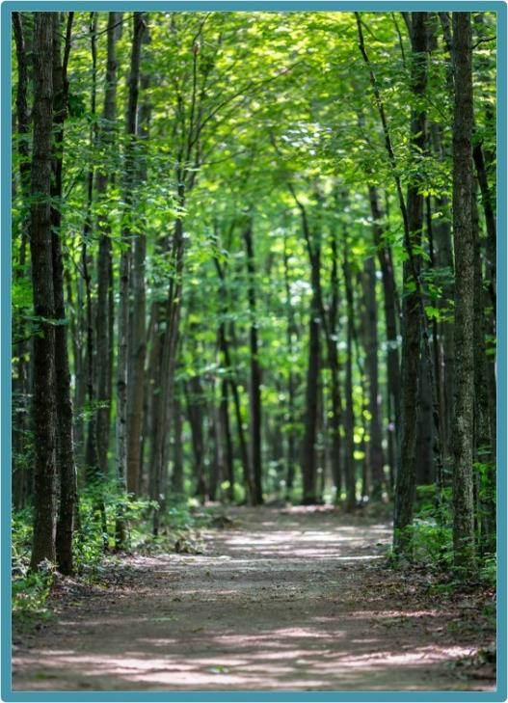
The Path to Leadership
I learned early there is no one meaning or approach to leadership; it is about building relationships and working with people to get things done. . . . It is about influencing and convincing others to go along with a course of action to reach a desired result. It’s about one’s own personal beliefs, attributes, and values that guide thinking, behavior, and actions. It is about earning the trust and respect of others.
(Tribal Educator, John W. Tippeconnic III, Comanche and Cherokee, 2015)
Notes:
2 minutes
Say:
Let’s think about the path to leadership. Think of tribal child welfare work as the forest with so many trees or crises to deal with daily that we often can’t see the forest for the trees. Taking an eagle’s view, you can see that leading requires not only understanding the individual tasks of staff but also cultivating the ability to see the patterns, relationships, context, and implications for growth. Being an effective leader is both active and reflective. Being able to take the eagle’s view that we talked about earlier today allows us to see the opportunities to improve our programs through leadership moments.
The “Indigenous Circles of Leading” model is informed by Indigenous leadership values, the grandfather teachings, and the understanding that we are making decisions that will impact the next seven generations and that we should be grounded in our “Indigenous Way of Being.” The relational view of tribal culture and communities has long been a place for healing, connection, and understanding how tribes have been “getting it right all along.” As we sit in this thought, let’s think about how Indigenous leadership shows up in our practice.

Slide 25
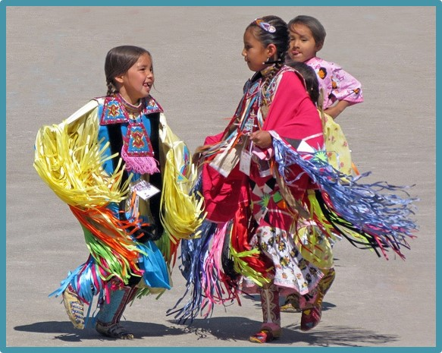
Indigenous Leadership in Practice
Holistic - based on Indigenous values and eagle’s view to plan for the next seven generations
Community - based on community health and wellness
Spiritually founded - no separation of church and state
Flexible - able to adjust quickly to current needs
Informal - not hierarchical; power and responsibility collectively shared
Situational - inclusion of others' gifts
Humility - focus on whole, not self; letting go; self-care
Notes:
45 minutes
Say:
In this session, we spent time describing the “Indigenous Circles of Leading” and the “Intergenerational Protective Circles of Care.” As we think about those concepts, we want you to work together to come up with some ideas to showcase with the group. Think about how these show up in your practice and in your tribal child welfare programs. Indigenous leadership in practice is symbolic of dancing in the moment, much like dancing to the beat of the drum in unison.
We will now break you into four groups, and each group will look at these seven leadership topics together and brainstorm how they show up in your work, at your organization, or even in your dream job. What practice really shows up in your experience? What is the most important? And how can you grow to incorporate more leadership practices into your work?
We will be available for any questions or thoughts you may want to discuss, so let us know if you need help or want to chat.
Do:
Pass out flip chart paper, post-its, markers, and loose paper for participants to explore their ideas.
Have participants break into small groups and give them 30 minutes to discuss how these leadership practices do, or could, show up in their work.
Alert participants when there are only five minutes left.
Give each group five minutes to discuss the main ideas they came up with and share examples.
Facilitator Note: Instruct participants that they could use any moments, personal or professional, for this topic. These are the further descriptions of each topic and can be used during a teach-back to ask deeper questions.
Holistic – based on Indigenous values and eagle’s view to plan for the next seven generations
• Taking the eagle’s view
• Using seasonal cycles
• Leaders asked to adapt through changes in attitude, beliefs, behaviors
• Understand trauma and resilience—leading in context
Community – based on community health and wellness
• Service to the community valued
• Works for the people more than for self-achievement
Spiritually founded – no separation of church and state
• Self-reflective practices using spiritual teachings and ceremonies to support change and healing
• Understanding and respecting that beliefs and ceremonial teachings are unique for individuals and their tribal nation. Historically, Christianity and biblical teachings have become a foundational way of life in many Indigenous cultures.
Flexible –able to adjust quickly to respond to current needs
• Requires transformative learning and shifts in perceptions and practices
• Able to challenge status quo
Informal – not hierarchical; power and responsibility collectively shared
• Shared authority rather than authority over
• Persuasive rather than positional authority
• Inclusive of many voices and gifts—as members of our communities we bring our gifts in service to one another
Situational – inclusion of others’ gifts
• Step forward when needed to use your gift/strengths
• Leadership moments acknowledged by everyone as a time for action
Humility – focus on whole, not self; letting go; self-care
• Okay to not know, make mistakes, try something else, take risks
• Okay with uncertainty, sitting in the moment, dealing with resistance, and letting go
• Self-care, reflection, re-creation, finding a new balance

Slide 26
Leadership From a Position of Authority
Task | Technical | Adaptive
Direction | Provide problem, definition, and solution (assign or bring in an expert) | Identify the underlying challenge; ask questions and bring up issues
Protection | Protect from external threats | Talk about external threats and work together to mitigate
Order
Orientation | Orient people in status quo roles | Question status quo roles; help to gradually shift people to new roles
Conflict | Restore order (if only temporarily) | Expose conflict or let it emerge naturally
Norms | Maintain status quo norms | Challenge norms or create opportunity for them to be challenged without retribution
Source: The Practice of Adaptive Leadership, Heifetz et al., 2009
Notes:
3 minutes
Say:
Finding yourself in a position of authority is challenging, especially coming from an Indigenous perspective. Combining leadership and authority is an old and understandable habit, and most feel more secure in an authoritative role because it’s easier to tell people what to do. We all want to believe that we can exercise leadership just by doing well at the job we are expected to carry out. But the distinction between exercising leadership and exercising authority is crucial. By practicing adaptive leadership BEYOND authoritative management, you risk telling people what they need to hear rather than what they want to hear. When leading in an authoritative way, we can also experience that we are not centered and balanced in our mental, spiritual, emotional, and physical ways. We know from the leadership model that this is what surrounds our “Indigenous Way of Being.”
You have three core responsibilities in an authoritative role: direction, protection, and order. You can practice adaptive leadership whether you are addressing a technical or an adaptive challenge, and the expectation is to clarify roles and offer direction or a vision. As part of organizational growth, think of this as being protective of young seedlings and maintaining stability. Reference: Heifetz, R. A., Grashow, A., & Linsky, M. (2009). The practice of adaptive leadership: Tools and tactics for changing your organization and the world. Harvard business press.)
The hierarchical approach is like a chain of command dictated through an organizational chart. The process is rigid and orderly, expertise is limited, and diversity is ignored. Often as information is hoarded, the environment becomes stagnant, much like a pool of water that sits without any movement so that the bacteria grow, unchecked, until most life within the water perishes.

Slide 27
Indigenous Adaptive Leadership
Indigenous Approach | Hierarchical Approach
Debate is encouraged | Debate is stifled
Environment is open, restless, and changing | Environment is stagnant
Participants engage in dialogue | Pronouncements are made, no dialogue
Knowledge is within us all | Knowledge is held by a few
Information is shared | Information is hoarded
Process is flowing, creative, noisy | Process is rigidly structured, ordered
Action by staff is encouraged | Action by staff is punished
Action for self is defined by self | Action for self is defined by others
Language includes all | Language includes some
Expertise is limitless | Expertise is limited
Diversity is recognized and appreciated | Diversity is ignored
Notes:
5 minutes
Say:
From a general sense, an Indigenous approach is open and relational, engaging others to be more creative through their expertise and diversity. This approach is indicative of our ancestral knowledge and practices.
Comparing and understanding the differences in an Indigenous and hierarchical approach is another consideration in the development of practice. You can find at times that you exist in and work with systems that have a hierarchical approach. As you think back to the “Indigenous Protective Circles of Care,” you can see that the Indigenous approach represents our ways of knowing, being, and doing. We talked about Indigenous leadership in practice on the earlier slide—you can see those ways reflected in that Indigenous approach. Focusing on the Indigenous approach keeps us in balance in our leadership and creates a landscape in which we can step into adaptive challenges in our programs. We are going to talk later about adaptive and technical challenges, and here we are laying the groundwork for how you as a leader can enter into adaptive challenges.
I will leave you with this thought from Adel Panahi’s Executive Book Summary for the groundwork – “Adaptive Leadership is about change that enables the capacity to thrive” from the Executive Book Summary: Adel Panahi. Change is like seasons, a continual process connected to our environment. This will be important information as we begin to discover leadership moments. Adaptive leadership is about change that enables the capacity building needed for children and families to thrive.

Slide 28
Discovering Your Leadership Moment
Eric Martin, Managing Director, Adaptive Change Advisors
https://youtu.be/AGLCqRmzR8o
Notes:
10 minutes
Say:
We are now going to listen to Eric Martin as he talks about leadership moments. As you watch Eric’s video, reflect on “who” can be a leader and how we recognize leadership moments.
Do:
Play the 4:55-minute video embedded in the PowerPoint slide.
Ask
Now that you have watched this video, what did you think about the leadership moment flags?
How can we recognize leadership moments?
Do:
Allow time for a few participants to share their thoughts.
Say:
Let’s look at recognizing leadership moments a little more.

Slide 29
Recognizing Leadership Moments
How to recognize a leadership moment:
Emotional escalation - you or someone else feels upset, excited, defensive, etc.; something is triggering you to respond (fight/flight/freeze)
Chronic or recurring problem
Gap between where you are currently and where you want to be (aspiration)
Logic alone doesn’t provide the answer
Making progress feels dangerous or scary
Making progress means stepping outside what you know into new terrain
Risky - must have difficult conversations without known outcomes
Notes:
5 minutes
Say:
In the “Indigenous Circles of Leading” model, the spring season is a growing period. Consider how a tree will adjust to the environment. If two trees sprouted close together, they adjust and become intertwined through their growth. These moments of adaptive growth guide your outcomes.
“Leadership moments are daily opportunities anyone can take to create change. They’re those moments that make your heart leap with hopeful anticipation—or with fear of taking the next steps. They hold promise for that long-awaited breakthrough or for the change you know is possible. They also hold the uncomfortable possibility that you, too, need to change. Leadership moments are grounded in the idea that leadership is something that anyone can exercise to achieve a better outcome than the one they’ve been offered. . . . When deployed using . . . adaptive leadership, a leadership moment can create sweeping change throughout teams, organizations, and entire communities.” Eric Martin – Your Leadership Moment: Democratizing Leadership in an Age of Authoritarianism
Ask:
Do you recognize any of these examples in your own leadership day to day? Quickly jot down some leadership moments in the “Recognizing Leadership Moments” handout in your workbook.
Say:
Start taking pauses during your workdays to recognize these leadership moments and how you are initially reacting to them.
Facilitator Note: Be able to provide some relevant examples. See below:
• In tribal child welfare leadership work, there are examples of leadership every day. How you as a leader answered that call from tribal council about a child removal—the racing heart, inability to share all the details that led to the removal to protect confidentiality but the opportunity you took to put forth that your staff is following policy and the child is safe.
• How the new caseworker spoke up while staffing a case for permanency to ask questions and point out a possible different option.
Say:
As leaders we all have leadership moments. As Indigenous people, we were all given gifts that we can use to serve our communities.
Now that we recognize where leadership moments can occur, let’s talk about technical and adaptive challenges leaders will face in their work.

Slide 30
Technical vs. Adaptive Leadership
Technical | Adaptive
Clearly defined | Harder to define
Clear solution and resolution | Unclear solution and recurring
Can be solved by expert | Stakeholders, not expert, needed
Everyone agrees on the problem and solution | Competing perspectives – emotion
Relatively short time to change | Requires long-term changes and adaptation
Leader can resolve by edict and authority | Stakeholders share responsibility – changes in attitude, beliefs, behaviors, and collaboration – risky
May require learning new information but not extensive | Transformational learning and shifts in perceptions
Faces little resistance | Avoidance, resistance, casualties, letting go
Notes:
10 minutes
Do:
Play the video on YouTube (https://youtu.be/YK8SFtYG1FM), “What Are Technical And Adaptive Problems” by Sousan Abadian - Defining Problems | Harappa Education (2:34 minutes).
Say:
Understanding the distinction between adaptive and technical work is critical to achieving your vision as a leader. It is important to note here that you spend only about 10% of your time in adaptive challenges, but if not seen as adaptive challenges, then they can continue to recur if technical solutions are only provided.
As you can see on the slide, you can define technical work by specific criteria, but the problem is that most of our challenges aren’t just technical. They require adaptive work.
What is different about an adaptive challenge? A challenge is adaptive when it requires something new—a new behavior, change of beliefs or values, knowledge, action, or way of thinking that is not in the group’s current expertise. In adaptive challenges, people don’t know how to solve the problem, and in fact, people often are the problem. Adaptive challenge is “growing a worker” by building their competency to be a critical thinker. It requires people to learn new ways, change behavior, reach new understandings, see the world through new filters, and work through the problem in a collective process. Bringing diverse voices to the table increases both the ability to recognize the adaptive challenge and the adaptive competence of the team.
Adaptive challenges can be painful because the process can be difficult, but as tribal child welfare leaders, many of us have already been practicing adaptive leadership. We are adapting our leadership when we are working with tribal leaders and tribal councils, which is different than working with state child welfare directors and state social workers. How we provide leadership for tribal vs. nontribal staff or for interns vs. tribal elders requires adaptive skills that inform and improve our leadership.
Ask:
What questions would you ask of the worker as an adaptive solution?

Slide 31
Margaret’s Story: Spring
https://youtu.be/sIdLtCDgxI8
Notes:
10 minutes
Say:
We are ending our focus on spring. Margaret’s story is another example of a leadership moment at the administrative level. We will be hearing about Margaret’s story in each season.
Margaret Orrantia was an early contributor to this leadership academy. In this video, she shares her story of the challenges she experienced coming in as a new tribal child welfare director to a struggling tribal organization. She describes the many challenges in her initial discovery.
As you listen to Margaret’s story, listen for the leadership moments and her responses.

Slide 32
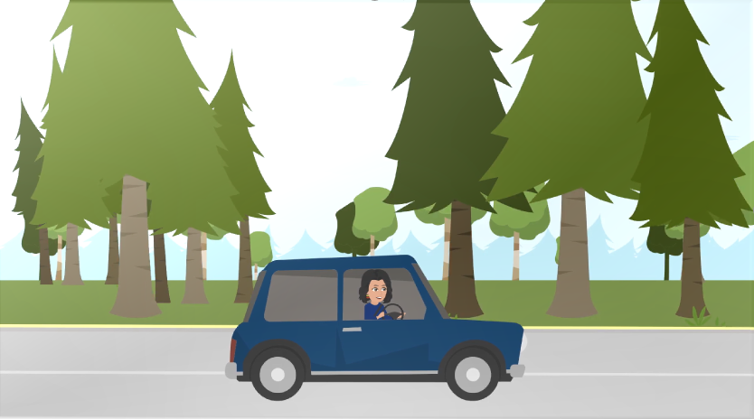
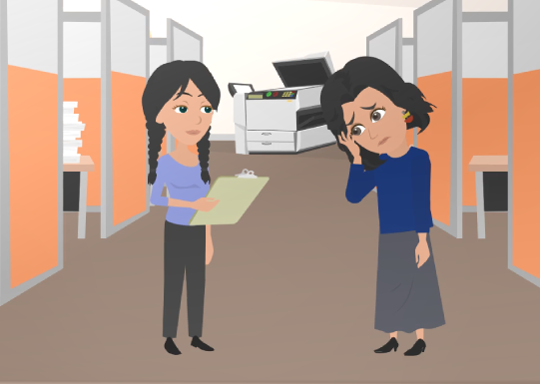
Case Study: Applying Margaret’s Story
Notes:
20 minutes
Say:
Now, for your last interaction in this season, we would like for you to apply what you heard in Margaret’s story to what you are starting to envision for your leadership role. You have a handout in your workbook that lays out what we would like for you to do for the next 15 minutes. When we come back together, we will have a few minutes to discuss what you want to share with the group.
Do:
Break participants into small groups. The members of this final group will stay the same for each end of season activity, applying Margaret’s concepts to their role and vision.
Alert participants when there are only five minutes left in their group time.
After 15 minutes, bring participants back together for a larger group discussion about what they came up with.
Facilitator Note: Here are the instructions from the case study handout:
As a group, you will now apply what you heard in Margaret’s story to your daily life.
Let’s imagine you have stepped out your door and into the fresh landscape of spring. The landscape has been touched by others for generations, and some remnants of past plantings are starting to sprout from the surface.
Your leadership role is like a fresh landscape each day. In your groups, brainstorm what it is that you would like to plant during your leadership role. Take an eagle’s view and think about where the ripples may appear when you start to grow in the area where you want to focus.
Imagine the possibilities that lie before you, but also think about the tools you may need to be successful in your leadership role.
Over the next few training days, you will continue to use Margaret’s story as a prompt for considering what you want your leadership journey to look like. Feel free to be creative! Draw pictures, use color, and explore what you want to grow!
Do:
Provide time for participants to share what they found useful from the case-study analysis and application.

Slide 33
An Eagle’s View
What did you learn about the spring in leadership?
How can the “Indigenous Circles of Leading” and the “Intergenerational Protective Circles of Care” help you in your leadership moments?
Notes:
5 minutes
Say:
As this season comes to a close, we are thankful for each of you allowing us to share this spring season training. We would invite you to do a little reflection before we leave as a group.
Facilitator Note: Only need one or two responses. If there are none, share some relevant examples.
Ask:
What did you learn about leadership in the spring?
How can the “Indigenous Circles of Leading” and the “Intergenerational Protective Circles of Care” help you in your leadership moments?
Do:
Revisit some reflections from the leadership model, protective circles of care, and adaptive leadership. Allow time for questions and any reflection moments participants may have.
Say:
Remember the date and time of the next session.

Slide 34
Ending Our Day
Together
in a Good Way
Notes:
10 minutes
Say:
We now want to end our day together in a good way.
Do:
Introduce closing arranged ahead of time. This could be a blessing, a talking circle, or even just sharing of a word that stuck with them from the day of training.

